Slide 1
Heart Disease Dataset Analysis
Group I

Slide 2
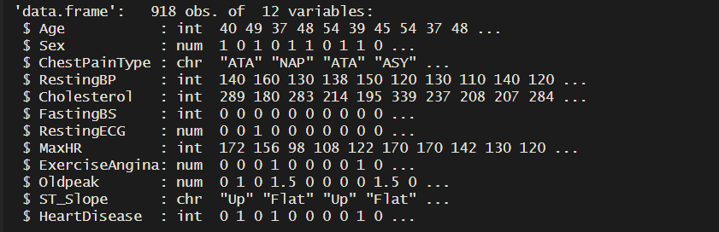
Data Exploration & Visualization
918 observations and 12 variables
10 variables are numeric and 2 are character

Slide 3
Data Exploration & Visualization
Variable | Definition | Mean | Std. Dev. | Min | Max
Age | Age of the patient in years | 54.00 | 9.432 | 28.00 | 77.00
Sex | Gender of patient (female=0, male=1) | 0.7898 | 0.4077 | 0.0 | 1.0
Chest Pain Type | Type of chest pain experienced: TA (Typical Angina), ATA(Atypical Angina), NAP (Non_Anginal Pain), ASY (Asympotomatic)
Resting BP | The resting blood pressure of the patient, measured in mm Hg | 132.4 | 18.514 | 0.0 | 200.0
Cholesterol | Total cholesterol level in blood, measured in mg/dl | 198.8 | 109384.000 | 0.0 | 603.0
Fasting BS | Fasting sugar level (means < 120mg/dl= 0, means > 120 mg/dl = 1) | 0.2331 | 0.4320 | 0.0 | 1.0
Resting ECG | Results of the resting electrocardiogram: Normal, ST, LVH | 0.1939 | 0.396 | 0.0 | 1.0
Max HR | The maximum heart rate achieved by the patient during exercise | 136.8 | 25.460 | 60.0 | 202.0
Exercise Angina | Angina (chest pain) induced by exercise (No =0, Yes=1) | 0.4041 | 0.491 | 0.0 | 1.0
Oldpeak | The ST depression induced by exercise relative to rest, measured in mm | 0.8874 | 1.067 | (-)2.6 | 6.00
ST Slope | The slope of the ST segment during exercise: Up (upsloping), Flat, Down (downsloping)
Heart Disease | The target variable: 0 = no heart diesease, 1= heart disease) | 0.5534 | 0.497 | 0.0 | 1.0

Slide 4
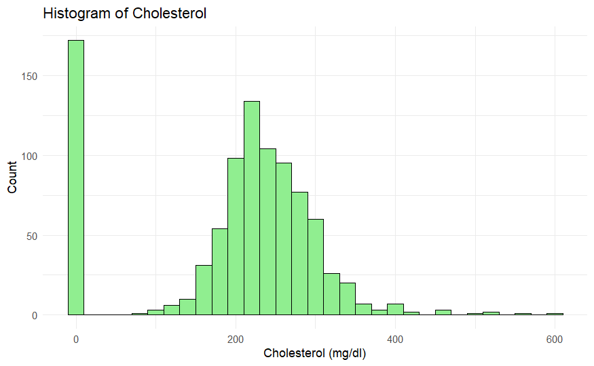
Data Exploration & Visualization

Slide 5
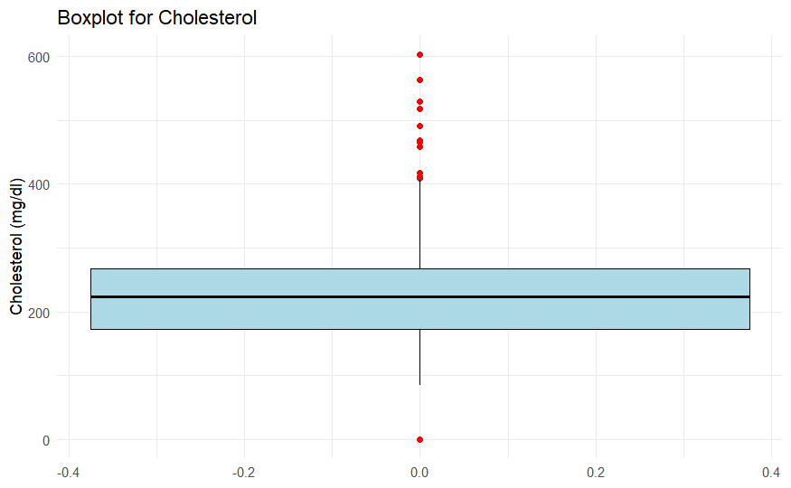
Data Exploration & Visualization

Slide 6
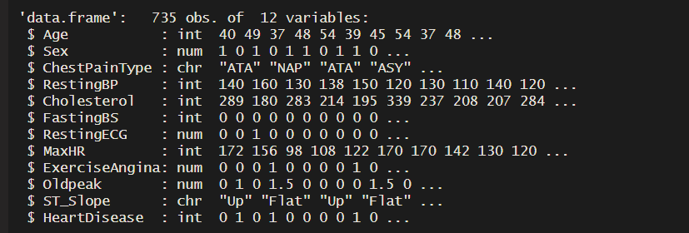
Data Exploration & Visualization
After removing the outliers: 735 obervations and 12 variables

Slide 7
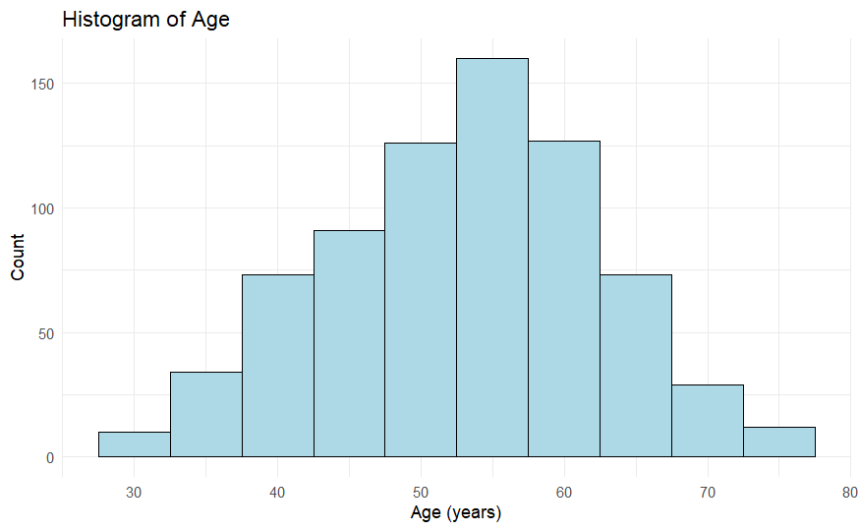
Data Exploration & Visualization

Slide 8
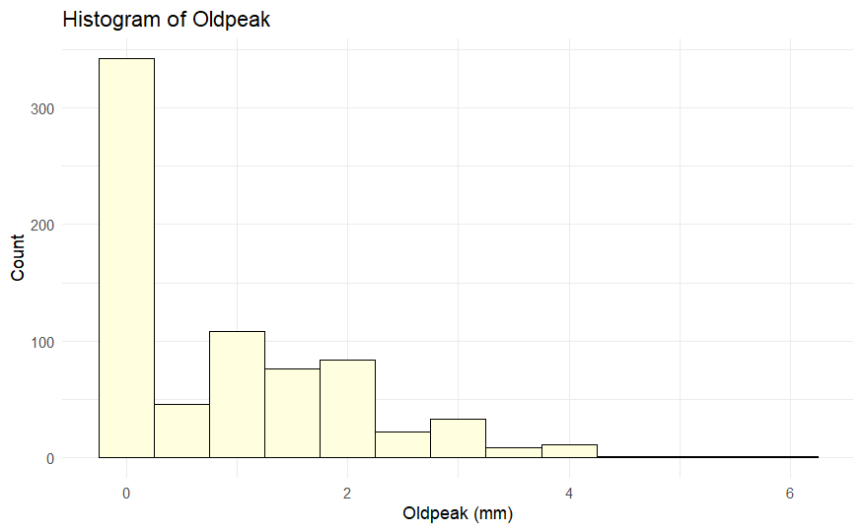
Data Exploration & Visualization

Slide 9
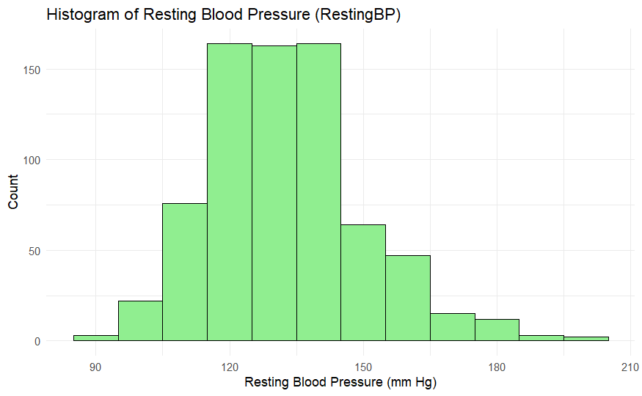
Data Exploration & Visualization

Slide 10
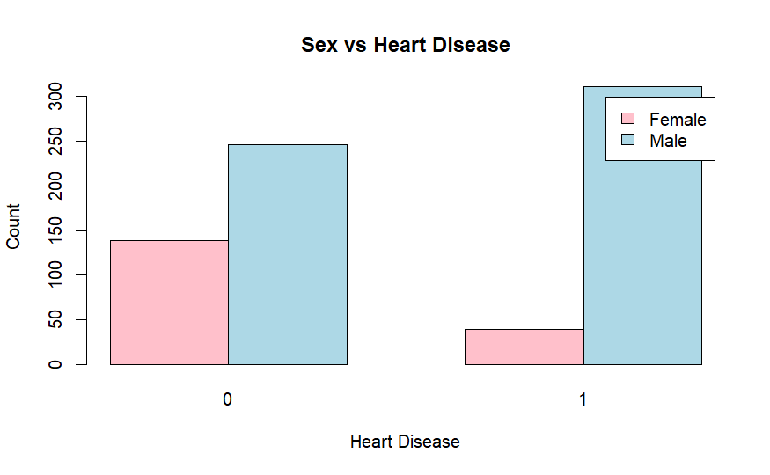
Data Exploration & Visualization

Slide 11
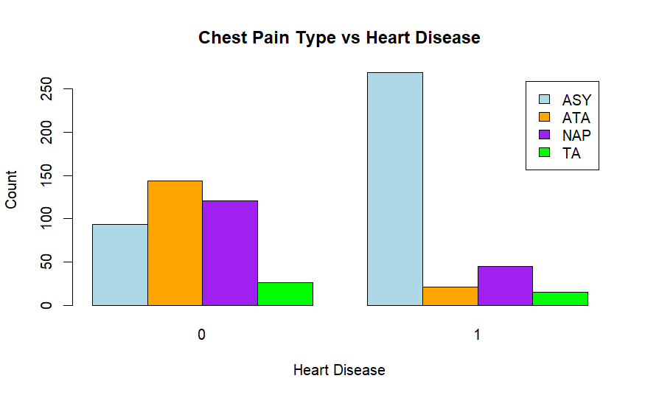
Data Exploration & Visualization

Slide 12
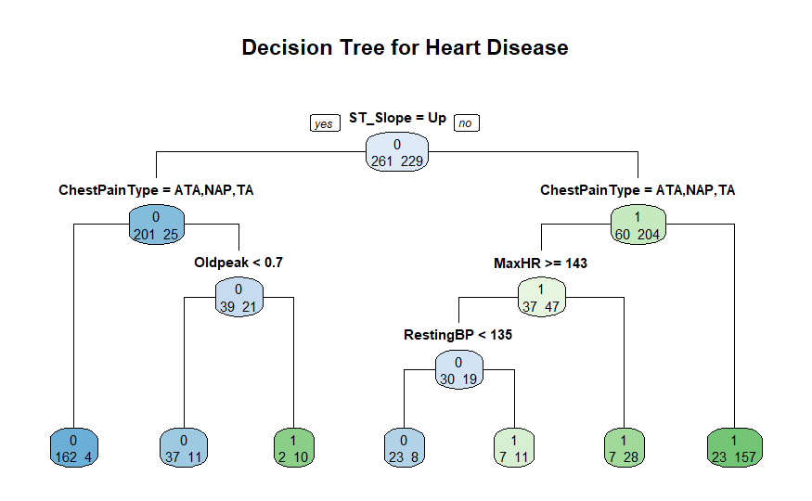
Decision Tree
Trainings Accuracy: 87.35 % , Test Accuracy: 83.67 %

Slide 13
Intepretation Decision Tree
True Positive: 84.08 %
False Positive: 15.92 %
False Negative: 9.39 %

Slide 14
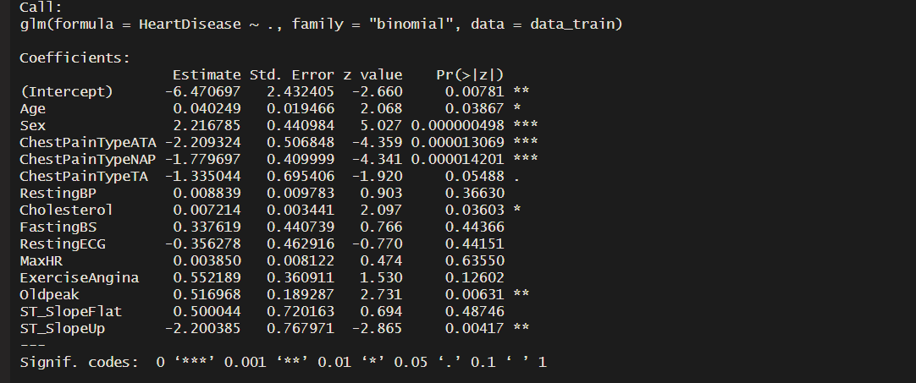
Logistic Regression
Trainings Accuracy: 87.07 % , Test Accuracy: 87.07 %

Slide 15
Intepretation Logistic Regression
Age: For each additional year of age, the odds of having heart disease increase about 4.1 %
Sex: Being male (compared to female) increases the odds of heart disease by a factor of 9.18
Chest Pain Type:
→ Having typical angina (ATA) decreases the odds of heart disease by approximately 89% compared to asymptomatic individuals
→ Having non-anginal pain (NAP) decreases the odds of heart disease by approximately 83% compared to asymptomatic individuals

Slide 16
Intepretation Logistic Regression
Cholesterol: For every unit increase in cholesterol, the odds of heart disease increase about 0.7%
Oldpeak: Each unit increase in Oldpeak (ST depression induced by exercise) increases the odds of heart disease by 68%
ST Slope: An upsloping ST segment reduces the odds of heart disease by about 89%

Slide 17
Sources
https://www.kaggle.com/datasets/fedesoriano/heart-failure-prediction

